Slide 1
Guide to Using Project Libre
For Gantt Charts and Budget

Slide 2
Steps to Build Gantt Chart
1. Complete dependency table with:
Id
Task name
Duration
Predecessor
2. Document your Assumptions:
Holidays
Start date
etc

Slide 3
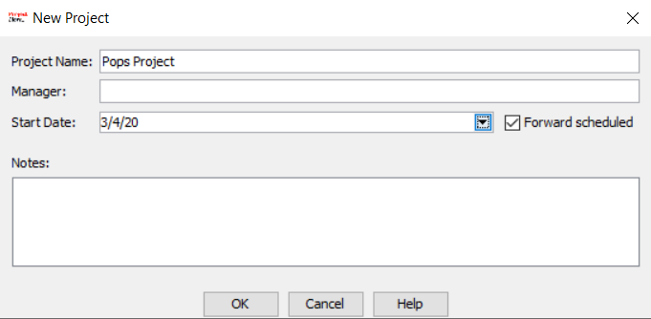
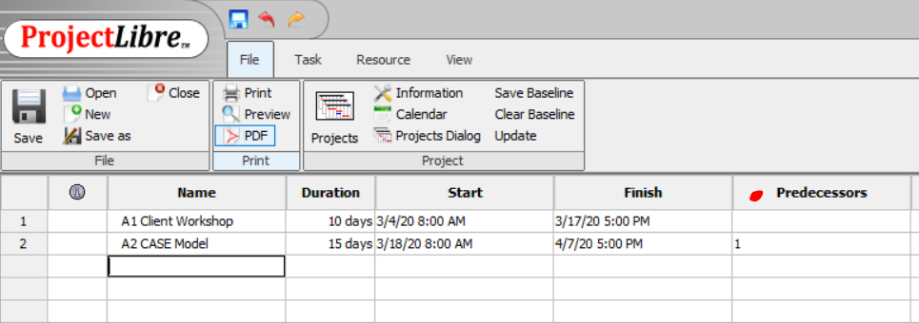
3. Open Project Libre
Click Create Project
Enter Project Name
Enter Project Start Date
To set milestones:
Create a milestone task name
Set Duration to ‘0’ days
4. Enter Task name, Duration and Predecessor into rows

Slide 4
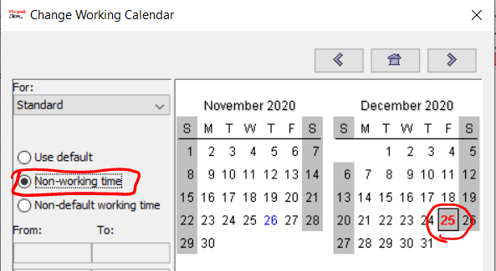
5. Add holidays
On FILE go to CALENDAR
Select dates
Set to NON-WORKING TIME
Repeat for all holidays
6. Add Project Summary Task
Insert New Task above task 1
Right click on ID 1
Choose New
Type in Name of Project
Select all Task below
On TASK click INDENT

Slide 5
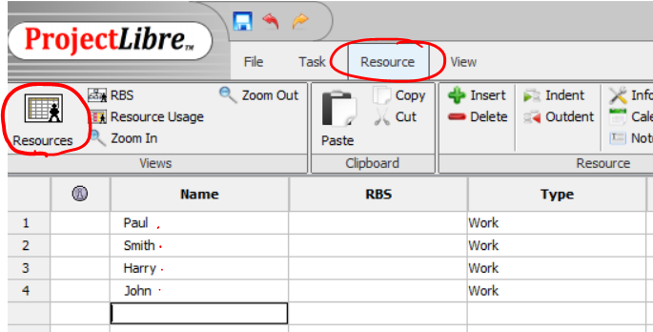
7. Add Total Slack Column
Right Click on Duration Column heading
Choose Insert Column
On Dialog box, choose Total Slack
8. Add Resources
Go to RESOURCES click Resources Button
Type in resource names
Use separate rows for
each resource
Add the Standard Rates

Slide 6
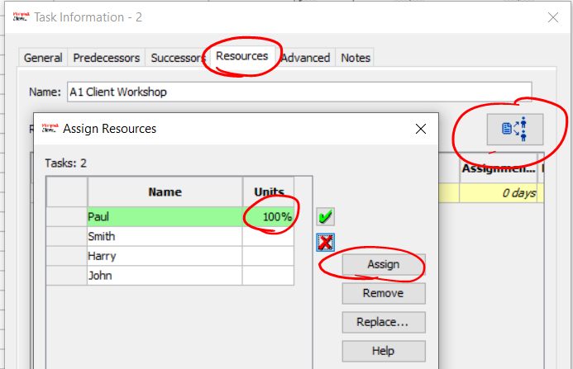
9. Assign Resources to Tasks
Go back to Gantt Chart view
TASK click Gantt
Double click first task
Go to Resources Tab
Click Assign Button
Select resource
Click Assign
Repeat for each Task
Insert COST Column

Slide 7
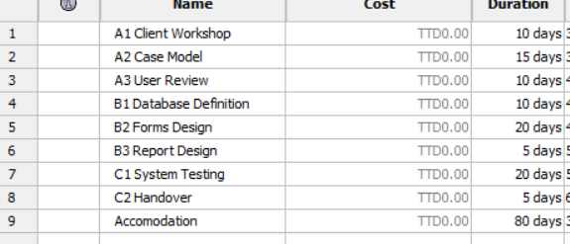
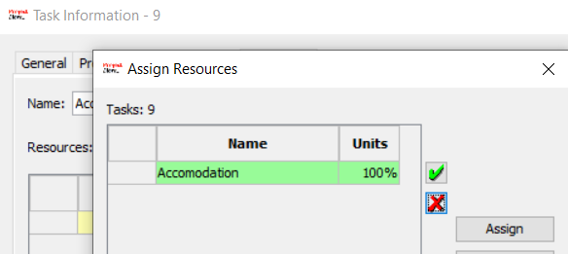
10. Add Overhead Cost Elements e.g. Accommodation
Go to Gantt Chart View
Add Cost Elements as a Task
Enter project Duration
Assign Resource to Task
Repeat for each Overhead Cost
element

Slide 8
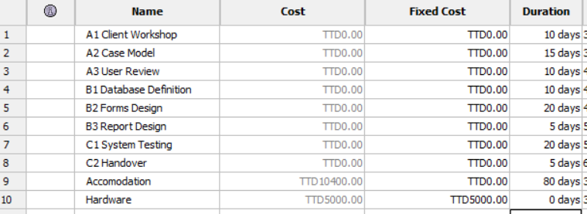
11. Add Fixed Cost to Gantt Chart
Go back to Gantt Chart view
Enter in new Row:
Name- the Fixed Cost Elements e.g. Hardware
Duration- ‘0’
Insert Fixed Cost Column
Enter the Amount in the Fixed Cost Column
Repeat for each Fixed Cost element

Slide 9
12. Screen Shots for Gantt Chart
Before:
Check that all the columns are visible
Task, Cost, Total Slack, Duration, Start, Finish, Predecessor, Resources
Check that all bars are visible
On TASK
Click Zoom Out
Once, OK
Use either Snipping Tool OR Prt Sc button on Keyboard
Paste into Final Report

Slide 10
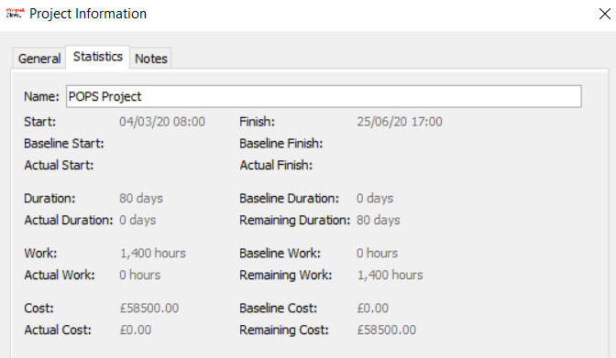
13. Screen Shots for Budget
Project Information Statistics Dialog Box
Cost per Resource
-> Go to Resource
-> RBS
Cost per Task
-> Go to Task
-> WBS

